Slide 1
Personalized Learning Analytics Assignment
By Skanda Vaidyanath

Slide 2
Roadmap of techniques used
Exploring the data
Basic text searches
High level technical and non-technical features
Clustering high level features
Topic Modelling and LDA
Vector Space Model
Self Organising Maps
Text Classifier
Curriculum for the course ‘Data Analytics and AI’

Slide 3
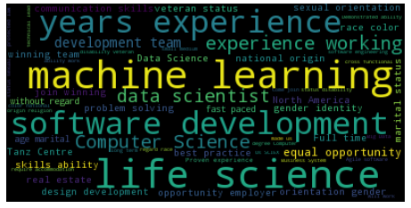
Stage 1 : Exploring the data

Slide 4
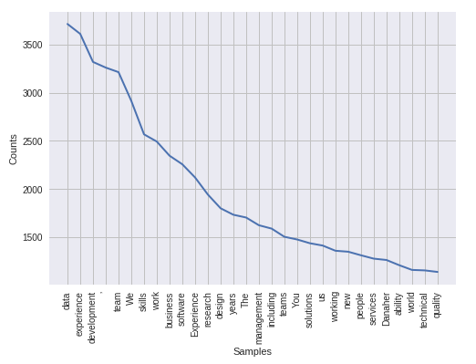
Stage 1

Slide 5
Stage 1
This stage just tells us about the data we are using and the different words that are a part of the Job Description column of the data. We observe some keywords such as ‘Machine Learning’, ‘Software development’, etc.

Slide 6
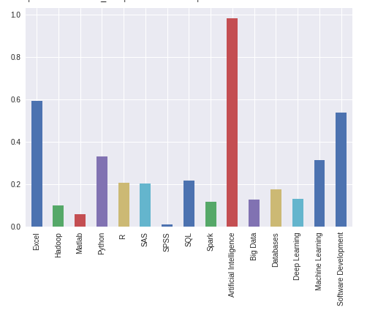
Stage 2 : Basic text searches

Slide 7
Stage 2
Gives us an idea of what the important skills are from the job postings. Shows that AI is a key skill which is a requirement of nearly all job postings while SPSS is not a very sought after skill. Comparisons between Python and R, SPSS and SAS etc. can also be made.

Slide 8
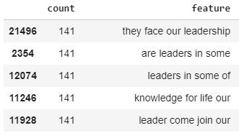
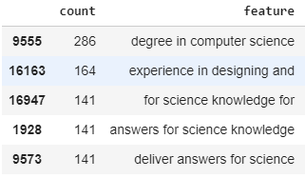
Stage 3 : High level technical and non-technical features

Slide 9
Stage 3
The image on the left in the previous slide shows some high level non-technical features while the image on the right shows some high level technical features.

Slide 10
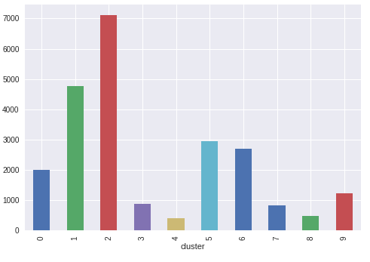
Stage 4 : Clustering high level features

Slide 11
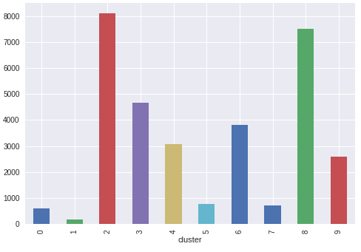
Stage 4

Slide 12
Stage 4
The figure on slide 10 gives cluster densities of non-technical features.
The figure on slide 11 gives cluster densities of technical features.
There are ten clusters of each. The description of each cluster is given in the following slides.

Slide 13
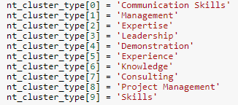
Stage 4
Non-technical features:

Slide 14
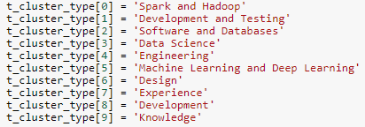
Stage 4
Technical features:

Slide 15
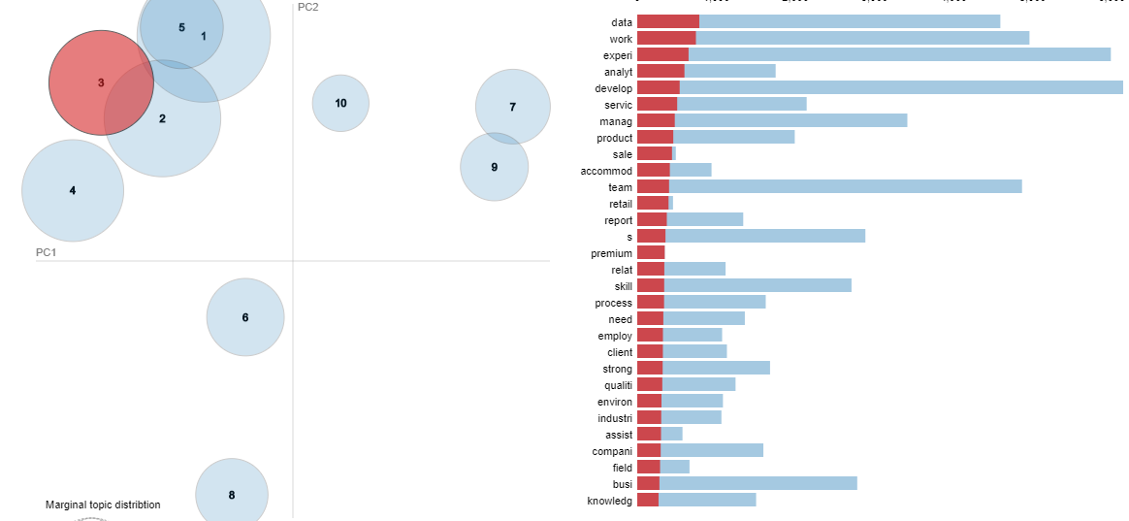
Stage 5 : Topic Modelling and LDA

Slide 16
Stage 5
The picture depicts the term distribution for topic number 3 on the right side. On the left side we can see the overall distribution of topics. The animation in the notebook is a great aid for understanding. I have used LDA only for visualisation in this particular assignment. This is mainly because our topic modelling is not very efficient in the sense that it does not spread across all four quadrants (left side of image) and there are many overlaps between topics.

Slide 17
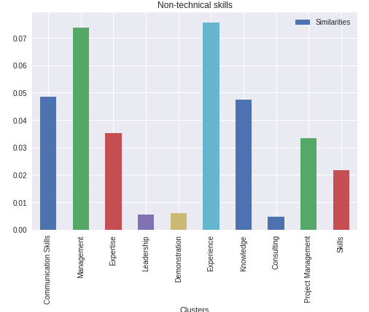
Stage 6 : Vector Space Model

Slide 18
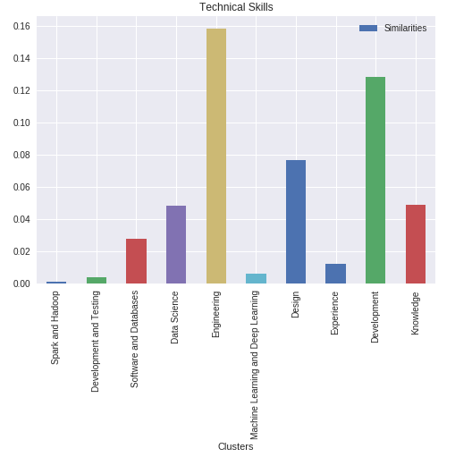
Stage 6

Slide 19
Stage 6
The figure in slide 17 shows the similarity with each cluster for document number 500. The figure in slide 18 shows the similarity with each cluster for document number 500. For this particular document, the most important non-technical skills are Management and Experience. Leadership and Consulting are not sought after. Similarly for technical skills, Spark and Hadoop and Machine Learning and Deep Learning are not sought after. Development and Design are important technical factors.

Slide 20
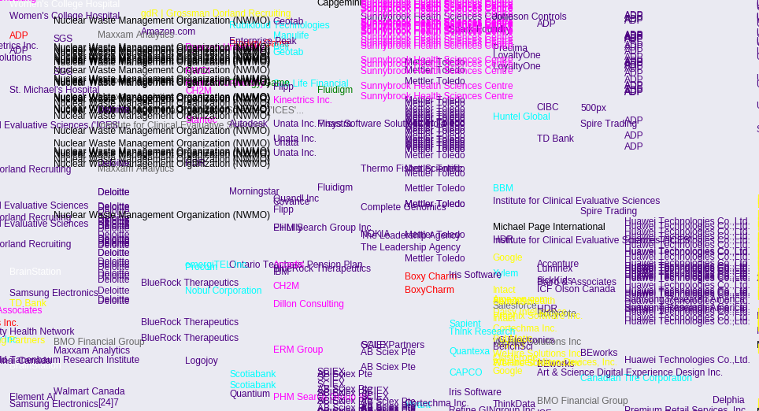
Stage 7 : Self Organising Maps

Slide 21
Stage 7
A section of the self organising map output is shown in the previous slide. From the map, we can make inferences about how similar or different the jobs of two companies are. For example, we can say Boxy Charm and Iris Software are offering similar jobs while Deloitte and TDB Bank are not.

Slide 22
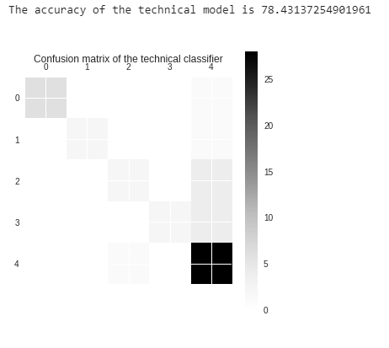
Stage 8 : Text Classifier

Slide 23
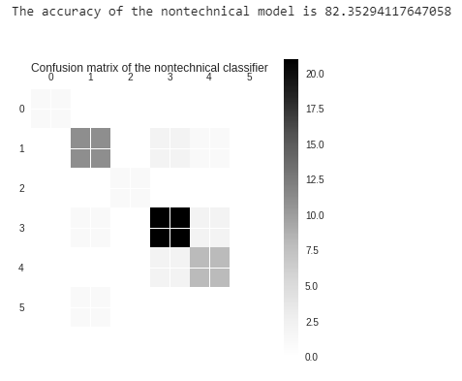
Stage 8

Slide 24
Stage 8
In slide 22, the confusion matrix of the technical text classifier is shown. The accuracy is 78%
In slide 23, the confusion matrix of the non-technical text classifier is shown. The accuracy is 82%
This classifier can be used to classify a new job posting into a technical bucket and a non-technical bucket.

Slide 25
Stage 9 : Design a curriculum for Data Analytics and AI
The details of this section are given in the Python notebook. Please refer the notebook for extensive details.

